Slide 1


Model Grid impacts
UNCLASSIFIED
Zhonglong Zhang, PhD, PE, PH and Lauren Melendez, MS
U.S. Army Engineer Research and Development Center, Environmental Laboratory
CE-QUAL-W2 Workshop
August 16 - 18, 2022
Environmental Systems
Modeling Team
UNCLASSIFIED

Slide 2
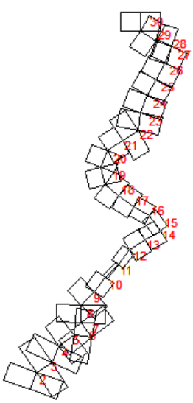
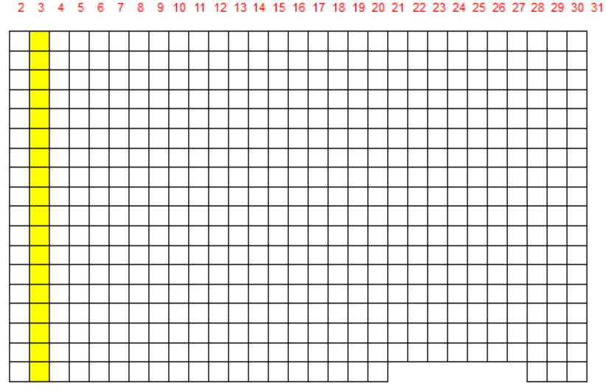
CE-QUAL-W2 Model Grids
Waterbodies/Branches/Segments/Layers
Defining the spatial resolution (Δx and Δz) for the model domain
Depending on the objectives of the study, the grid discretization may be made coarser or finer.
Increasing spatial resolution can severe penalty in terms of turnaround time for running the model
Model results should not be a function of the grid resolution or the model timestep.

Slide 3
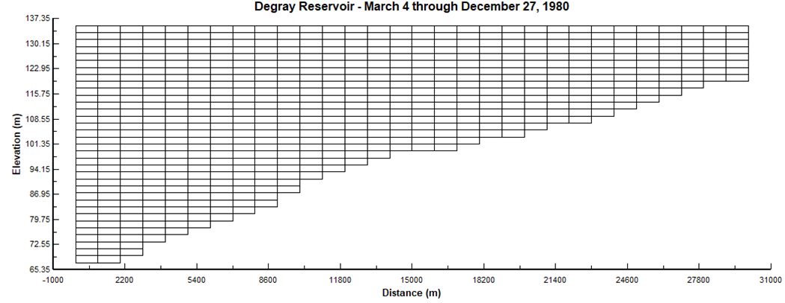
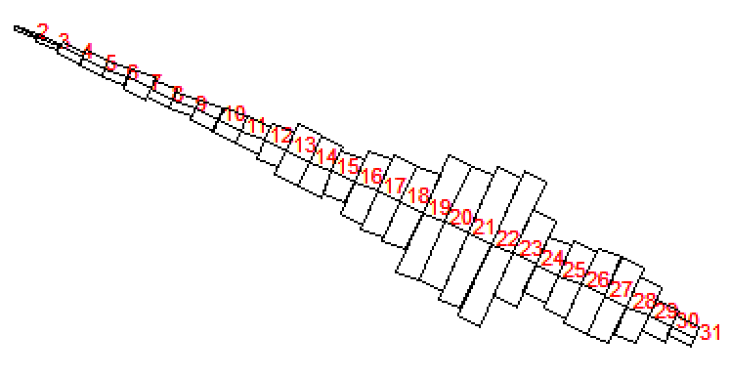
Model Grids - DeGray Reservoir
Branch length 30 km
Segment lengths 1000 m
Maximum width 5530 m
Layer height 2 m
Upstream segment 2
Downstream segment 31

Slide 4
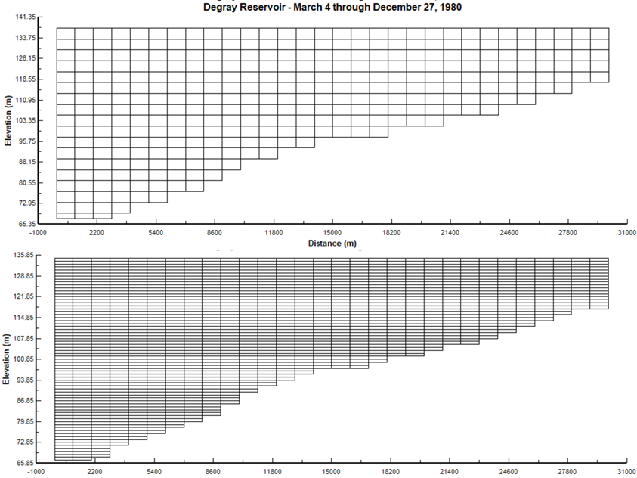
Model Grids - DeGray Reservoir

Slide 5
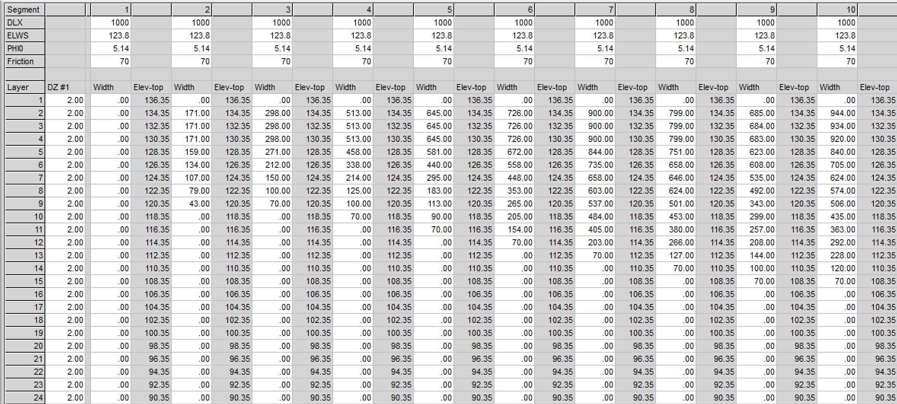
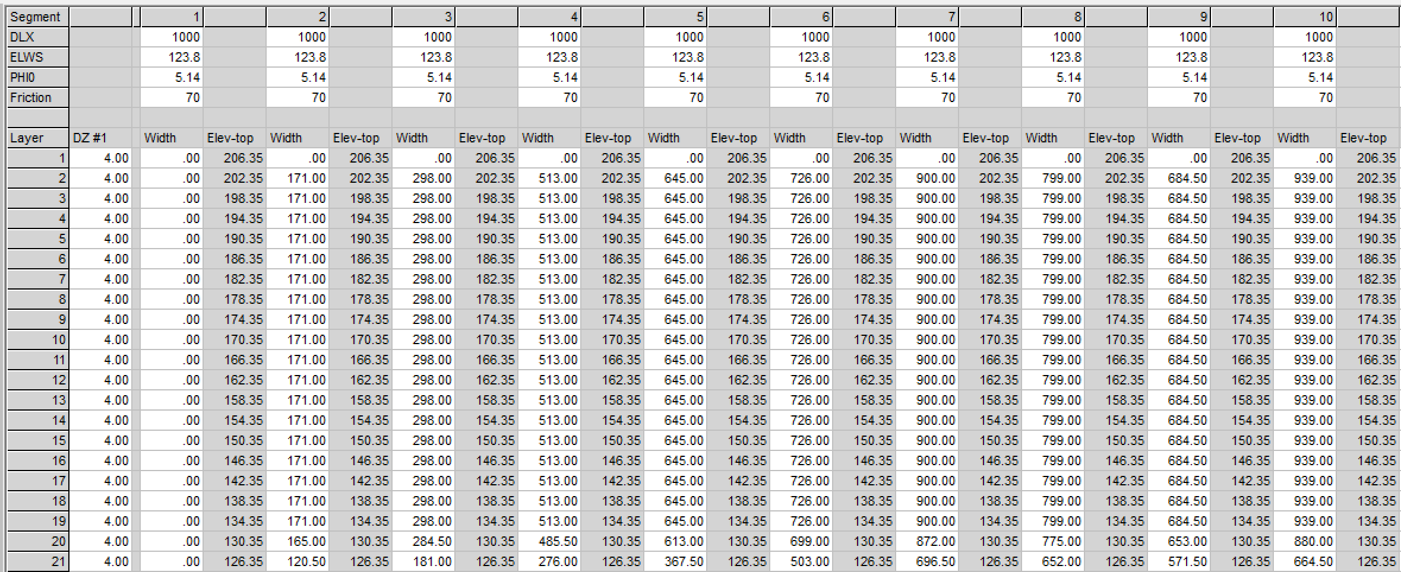
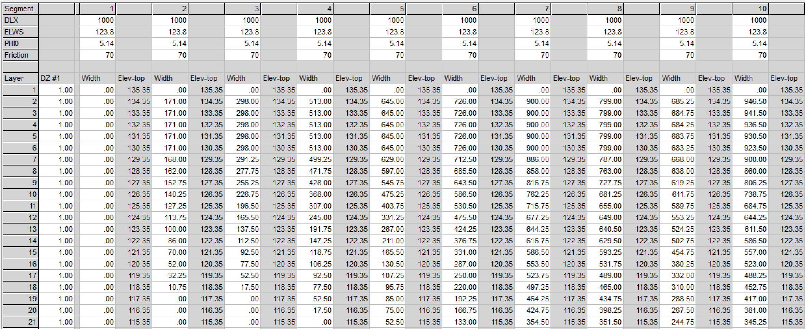
Bathymetry Files
segment lengths
water surface elevations
segment orientations
bottom friction
layer heights for each segment, and
average widths for each grid cell.

Slide 6
Reservoir Elevation vs Volume
From this comparison, the model grid was determined to be an accurate representation of the reservoir’s bathymetry.

Slide 7
Predicted Water Temperature Profiles

Slide 8
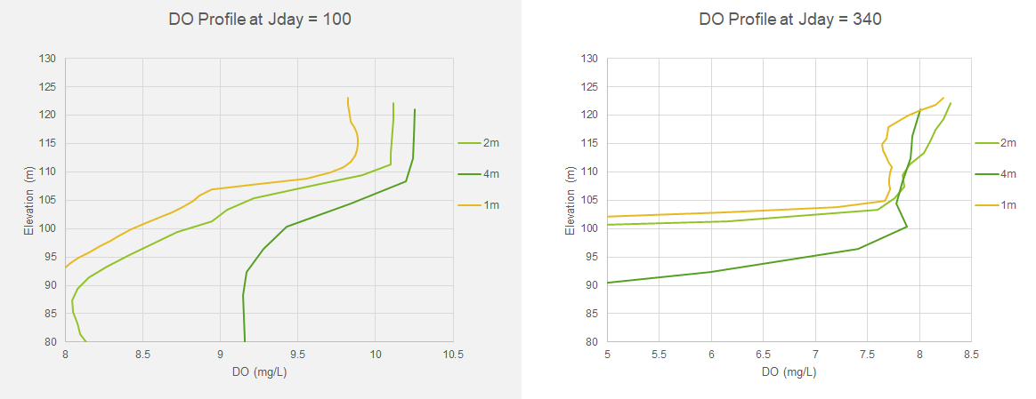
Predicted Dissolved Oxygen (DO) Profiles

Slide 9
Hands-on Exercises
Review the differences of bathymetry files
Layer height = 2 m (bth1.csv)
Layer height = 1 m (bth1-1m.csv)
Layer height = 4 m (bth1-4m.csv)
Run the DeGray reservoir W2 model with the new bathymetry files and note the differences in run time.
Compare the differences of predicted 1) water temperature, dissolved oxygen profiles (spr.csv) and 2) withdrawal (two_31.csv) for the 2 m, 1 m and 4 m layer heights

Slide 10

Questions?

